Slide 1
Chapter 8 Perimeter and Area Part 1

Slide 2
Areas of 2D shapes
Rectangle (including Square)
Triangle
Circle
Parallelogram (including rhombus)
Trapezium

Slide 3
1.1a: Rectangles
L
B
Area = L × B

Slide 4
1.1b: Squares (special case of rectangles)
S
S
Area = S × S = S²

Slide 5
1.2: Triangles
H
H
B
B
Area = ½ ×B × H or (B × H)/2
Important!! The “B” and “H” MUST be perpendicular to each other – they must meet at 90°

Slide 6
1.3: Circles
R
Area = π r ²
Don’t confuse this with the formula C = 2 π r, which gives circumference (perimeter)

Slide 7
1.4: Parallelograms
H
B
Area = B × H
Important! Like in triangles, the B and H must be at right angles (perpendicular). H is the Perpendicular Height, NOT distance up the side!

Slide 8
1.5: Trapeziums
a
h
b
For these, you need 3 measurements....
“a”, one of the two parallel sides
“b”, the other parallel side
“h”, the perpendicular height
Area =

Slide 9
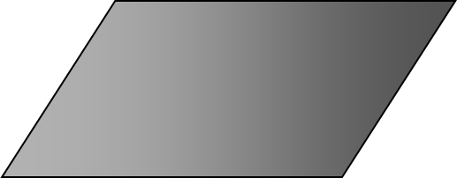
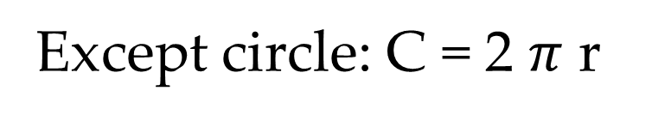
Perimeter
8 cm
Add up all the sides
5 cm
5 cm
$$5 cm+5cm+8 cm+8 cm=26 cm$$
8 cm
Except circle: C = 2 $π$ r

Slide 10
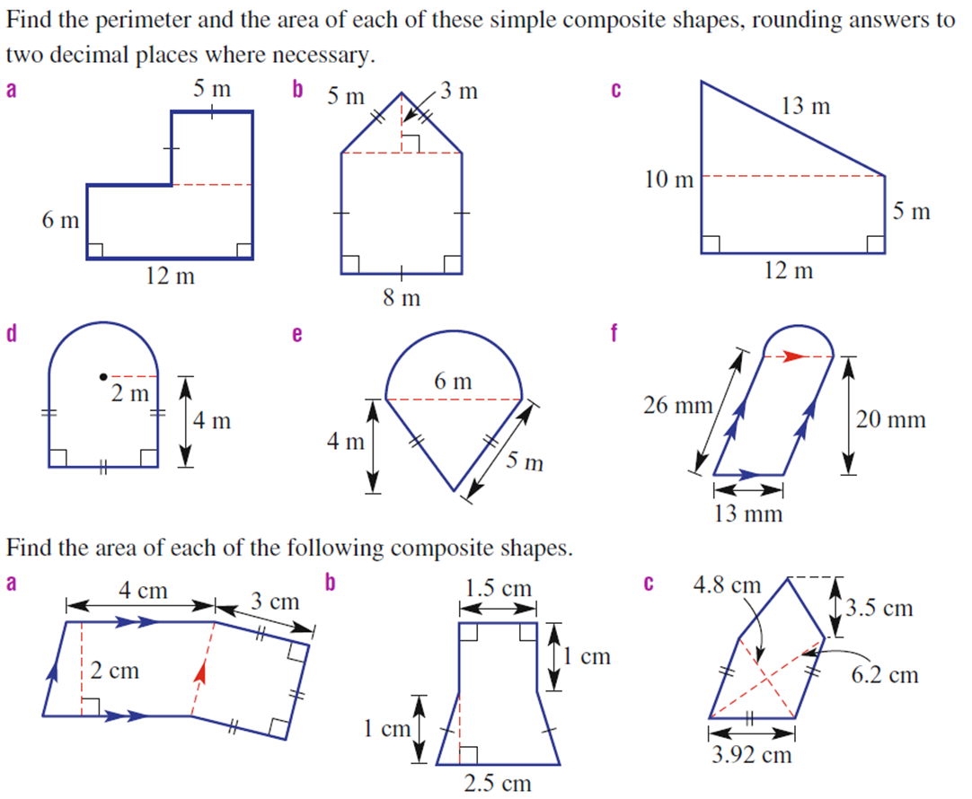

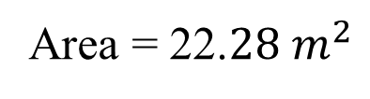



Find the area and perimeter
4 m
4 m x 4 m = ${16 m}^{2}$
4 m x 4 m = ${16 m}^{2}$
Area = ½ π r ²
2 m
Area = ½ π 2 ²
Area = ${16 m}^{2}$ + 6.28 ${ m}^{2}$
Area = ½ 4π
Area = 22.$28{ m}^{2}$
Area ~ 6.28 ${ m}^{2}$

Slide 11
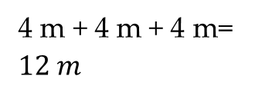
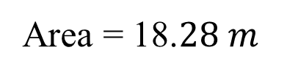


Find the area and perimeter
4 m
4 m + 4 m + 4 m= ${12 m}^{}$
Area = ½ 2π r
Area = π r
2 m
Area = π 2
Area = ${12 m}^{}$ + 6.28 ${ m}^{}$
Area = 18.$28{ m}^{}$
Area ~ 6.28 ${ m}^{}$

Slide 12
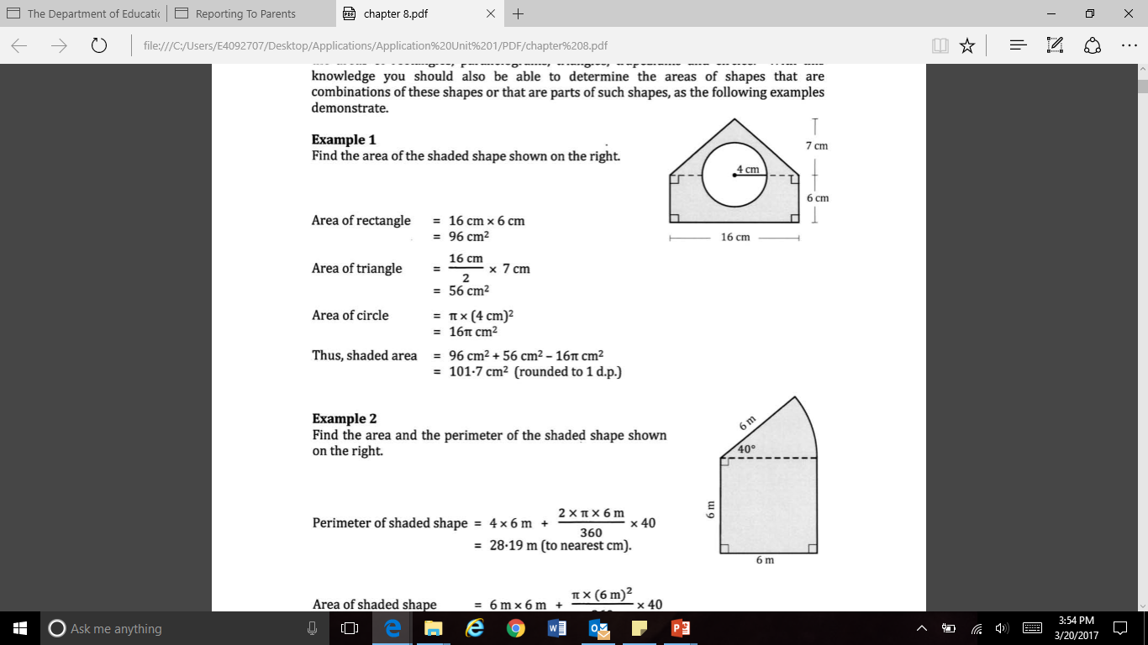

Slide 14
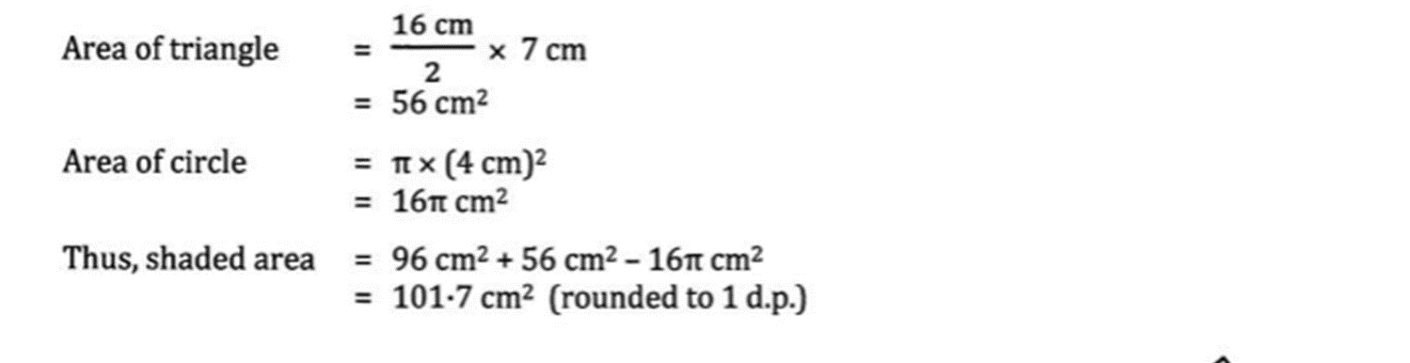

Slide 16
Summary of formulae in this section
Shape | TSA Formula
Prisms | TSA = total area of all faces Rectangular Prism: 6 faces (if closed) Triangular Prism: 5 faces (if closed)
Cylinders | TSA = 2 π r h (for the curved wall) + π r² for each circular end if there is one
Spheres | TSA = 4 π r²
Cones | TSA = π r L (for the curved wall) + π r² for the circular base if there is one
Pyramids | TSA = Base area + area of the triangular sides.

Slide 17
Cones - formulae
L
r
Area of the curved wall = π r L
L is called “slant height”

Slide 18
2.4: TSA of a Sphere
r
TSA = 4 π r²
Example
TSA = 4πr²
Note r = 5
= 4π × 5²
10cm
= 314.16 cm²

Slide 19
2.5: TSA of a Pyramid
Rectangular-based pyramids (closed) have five faces:
(1) a base – only one of these!
(2) a front & back triangular side (same size)
(3) a left & right triangular side (same size)
If it’s a square based pyramid, all 4 sides are the same size!

Slide 20
Summary of formulae in this section
Shape | Volume Formula
All prisms Rectangular Prism Triangular Prism Trapezoidal prism Cylinder Cube | Volume = Area of Base × Perp Ht For a rectangular prism, V = LBH For a cube, V = S³ For a cylinder, V = πr²h
“Pointies” Cones Pyramids | Volume = 1/3 × Area of Base × Perp Ht
Spheres | Volume =
All volumes are in cubic units – m³. cm³, mm³
Because Volume is 3 – DIMENSIONSAL!

Slide 21


3.1: Volume of a Prism
Prisms are shapes that have a pair of identical, parallel ends (the “base” and top)
and straight sides (the “height”) perpendicular to the base.
Any cut (called a cross-section) made through the shape parallel to the top or base will result in exactly the same shape as the base or the top.

HEIGHT
BASE
Volume of any prism =
Base Area x Perpendicular Height

Slide 22
3.2: Volume of a “Pointy” shape : Cones and Pyramids
H
H
B
L
Base = πR ²
Base = L x B
V = 1/3 × base area × perp ht
V = 1/3 × base area × perp ht

Slide 23
3.3: Volume of a Sphere
11cm

Slide 24
Special conversions you need to know
Length measure
1-dimension
Area/TSA measure
2-dimensions
Volume measure
3-dimensions
100cm = 1m
10 000cm² = 1m²
1 000 000cm³ = 1m³
1000mm = 1m
Note 10 000 is 100² or 100 x 100
Note 1 000 000 is 100³ or 100 x 100 x 100
10mm = 1cm
1 hectare = 10000m²
1 000 000mm² = 1m²
1 litre = 1000cm³
1m³ = 1000 litres
1cm³ = 1 mL

